Slide 1
Azure Mobile App
How-to create a backend on cloud for your game

Slide 2
Agenda
Overview
Server Side Features
.NET backend
Push Notifications
Authentication
Offline Sync

Slide 3



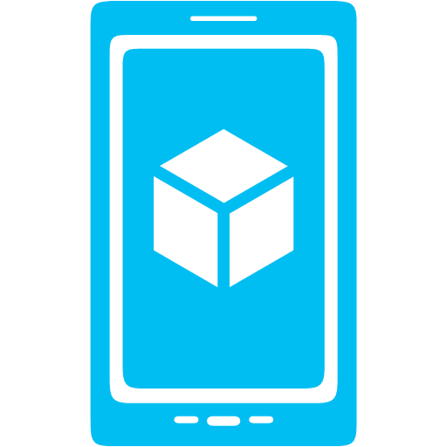









Azure Mobile App
Storage
Authentication
Push Notification

Slide 4
Server Side features
Node.js scripts
.NET Web API
backend in
Visual Studio
Passes through to SQL by default
MongoDB, Table Storage, SQL out of the box
Intercept CRUD requests to tables
Fully customizable

Slide 5
Web API based w/ additional functionality, developed in and deployed from Visual Studio
TableController data context can map to SQL, Table Storage, Mongo, etc
Pull in NuGet modules and other .NET libraries
Set permissions with attributes on classes
Local Debug
.NET Backend

Slide 6
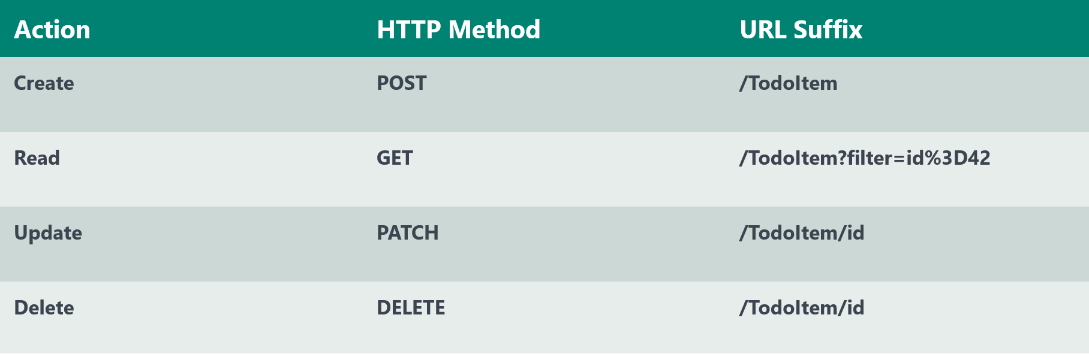
The REST API
Base Endpoint: https://MobileService.azure-mobile.net/tables/*

Slide 7
Non-table based endpoints
Accessible from
GET
POST
PUT
PATCH
DELETE
For node.js logic in scripts like table endpoints
For .NET delivered through a WebAPI
Expose any functionality you want
Custom API

Slide 8
Push Notification
Client
Mobile Services
Register for push notifications with PNS
Send your identifier to Mobile Service
Send push from server scripts
PNS delivers notification to device
App
(2)
(3)
(4)
(1)
PNS
Notes:
Speaking points
Push notifications work the same no matter which client you’re working with
Client talks to PNS to register for push
Client gets token, passes to Mobile Service
Mobile Service asks PNS to deliver payload to token / channel URI / registration ID
PNS delivers push to client app
PNS = Push Notification Service (i.e. MPNS, WNS, GCM, ADM, APNS)

Slide 9
User Auth Flow (server)
GOOGLE
CREDENTIALS (via oAuth/WebView)
FACEBOOK
DEVICE
TWITTER
AUTH TOKEN
GRAPH ACCESS (LIMITED)
MICROSOFT ACCOUNT
IDENTITY
AAD
MOBILE SERVICE
Notes:
Speaking Points
Server auth flow uses OAUTH
Mobile Service is registered with provider to allow auth
Client calls auth method and passes in provider name
User authenticates, Mobile Service and provider do OAUTH
User ID and token (for Mobile Service) returned to client
Provider token / secret accessible in Mobile Service

Slide 10
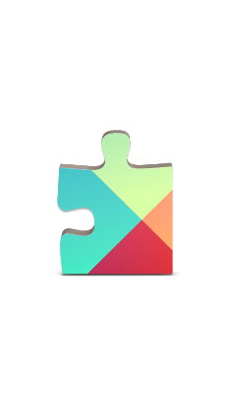
User Auth Flow (client)
CREDENTIALS (via native SDKs)
GOOGLE
AUTH CODE + TOKEN
FACEBOOK
DEVICE
GRAPH ACCESS
TWITTER
GRAPH ACCESS
MICROSOFT ACCOUNT
AUTH CODE
IDENTITY
AAD
MOBILE SERVICE
Notes:
Speaking points
Client flow uses SDKs for provider / platform
User auths using SDK on client
Provider token / secret sent to Mobile Service
Mobile Service checks validity and hands back user ID and token

Slide 11
Offline Sync
SQL Database
Conflict resolution
TableController
(with optimistic concurrency)
BYOD
SQLite
Explicit Push/Pull
Table Storage
Device
Mobile Service
MongoDB

Slide 12
DEMO

Slide 13
Questions...?

Slide 14
Thank you ☺

